Slide 1
Structured Prediction as Translation between Augmented Natural Languages
Giovanni Paolini, Ben Athiwaratkun, Jason Krone, Jie Ma, Alessandro Achille, Rishita Anubhai, Cicero Nogueira dos Santos, Bing Xiang, Stefano Soatto
Amazon Web Services
Presented by Björn Bebensee (2019-21343)
Department of Computer Science and Engineering, Seoul National University

Slide 2
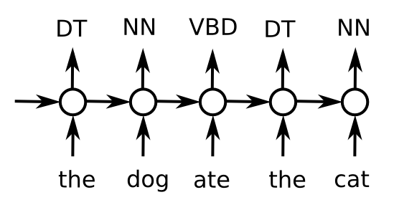
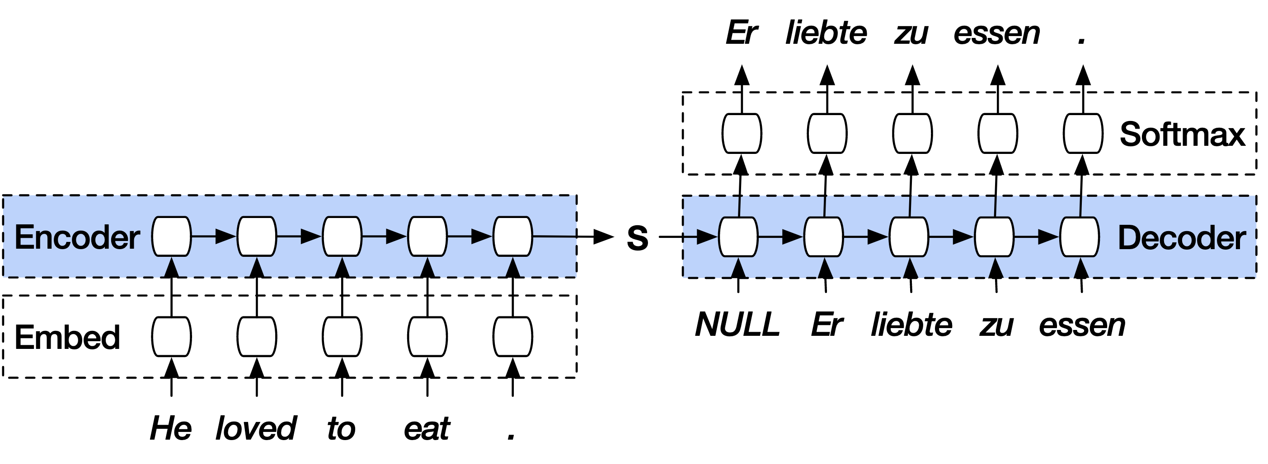
What is structured prediction in NLP?
Instead of predicting some continuous value, the model’s output space is structured.
Unlike in multiclass classification: size of the output space is often exponential, thus difficult.
Image: Stephen Merity
Image: Mat Kelcey, stackoverflow.com

Slide 3
Agenda
Brief overview of tasks
Motivation and related work
Proposed method
Key idea
Joint entity and relation extraction
Named entity recognition
Relation classification
Semantic role labeling
Coreference resolution
Experimental results

Slide 4
Structured prediction tasks
Let’s have a look at some structured prediction tasks in NLP!

Slide 5
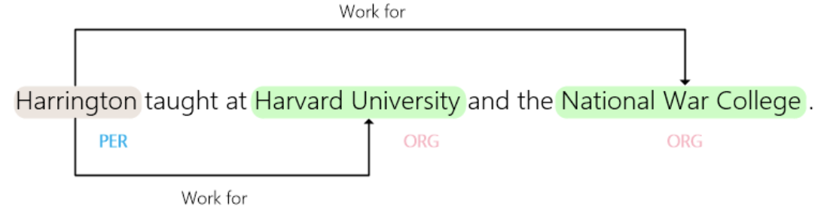
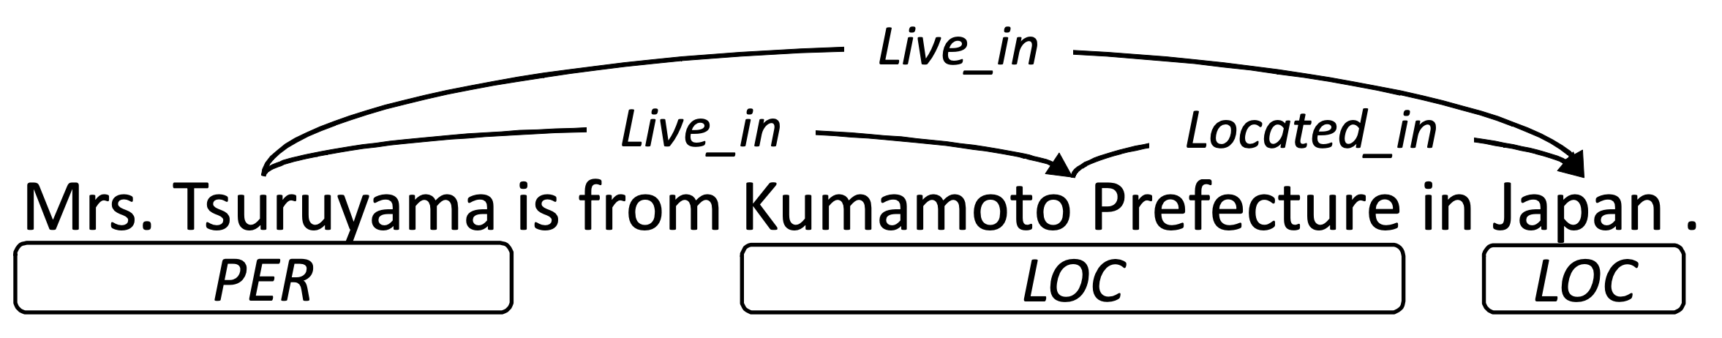
Joint entity and relation extraction
Given: one or multiple sentences
Output: entities, their categories, and how they are related
Miwa and Sasaki, EMNLP 2014.
Zhang et al., Applied Sciences 2021.

Slide 6
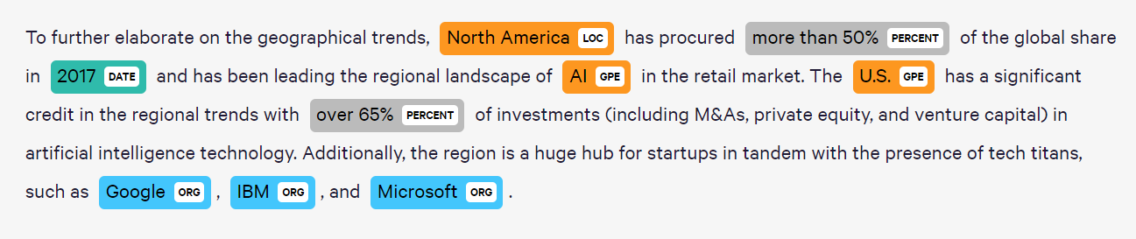
Named entity recognition
Given: one or multiple sentences
Output: predict which words are entities and their categories
A special case of joint entity and relation extraction w/o relations
Image: Huggingface

Slide 7
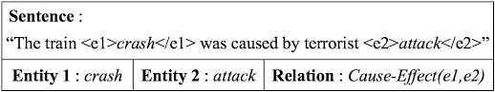
Relation classification
Given: a sentence, multiple entities
Output: predict their relation
Lee et al., Symmetry 2019.

Slide 8
Semantic role labeling
Given: a sentence, a predicate
Output: how each noun, adverb relates to the predicate, i.e. answer the question “who did what to whom?”
The police officer detained the suspect at the scene of the crime at noon.
Agent
Predicate
Theme
Location
Location
Time

Slide 9
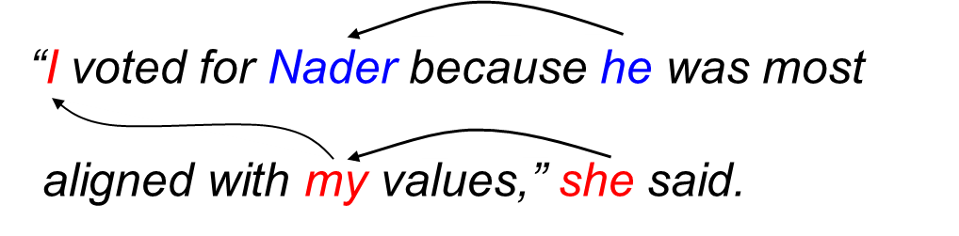
Coreference resolution
Given: a text, typically consisting of multiple sentences
Output: identify all expressions referring to the same entity (i.e. “her”, “his”, etc.)
Image: Stanford Natural Language Processing Group

Slide 10
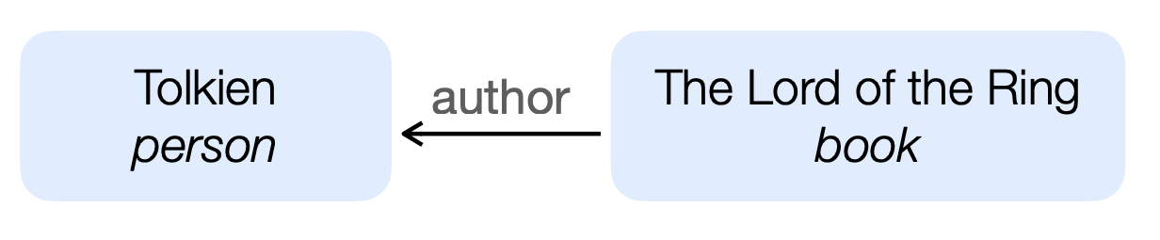
Motivation
Recent work: mostly task-specific approaches on top of features extractors like BERT.
Disadvantages:
Does not take advantage of semantics of class labels: the classifier does not know that an “author” is also a “person”
Task-specific architectures needed

Slide 11
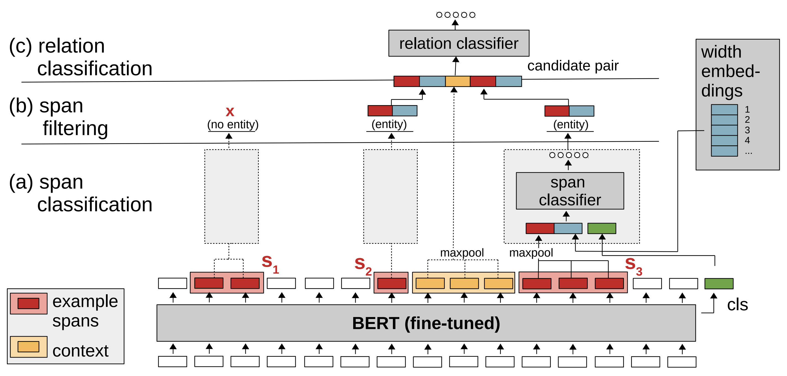
Related work: Joint entity and relation extraction
Athiwaratkun et al., arXiv 2020

Slide 12
Key idea
Augmented natural language: annotate language using special symbols, i.e. “[ … ]” for entities and “[ … | category ]” to categorize them
Athiwaratkun et al., arXiv 2020
Frame structured prediction task as text-to-text translation:
Input: source text, task
Output: source text annotated with the answers, i.e. all entity categories and their relations
Answers are easy to extract from bracket annotations

Slide 13
Key idea
Advantages of this approach:
Only requires a single architecture for translation
Translation model understands and can take advantage of label semantics, i.e. a “person” is more likely to be “author” than a non-person
It’s possible to train a single multi-task model that can complete all tasks.
Knowledge is transferred from one task and dataset to the other, benefits low-resource tasks. ☺

Slide 14
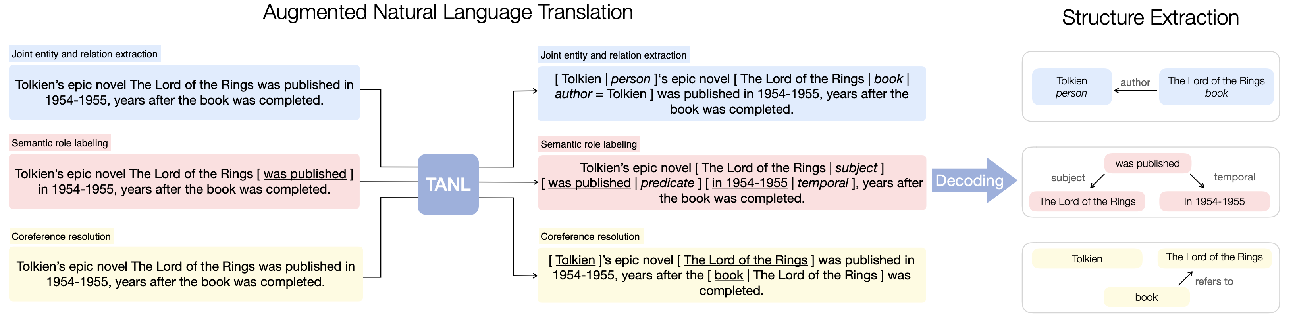
Proposed method

Slide 15
Proposed method
Use Google’s pre-trained T5-base model for translation (but: any generative pre-trained model can be used).
Single-task model: fine-tune to translate between source sentence and augmented natural language that contains answers.
Multi-task model: simultaneously train on all tasks, provide name of task and dataset so that model knows what to predict as prefix.

Slide 16
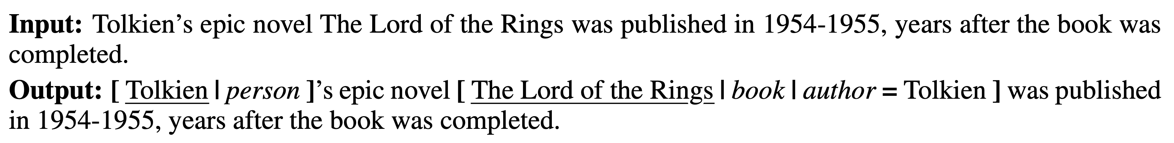
Proposed method: examples
Joint entity and relation extraction:
Relation classification:

Slide 17
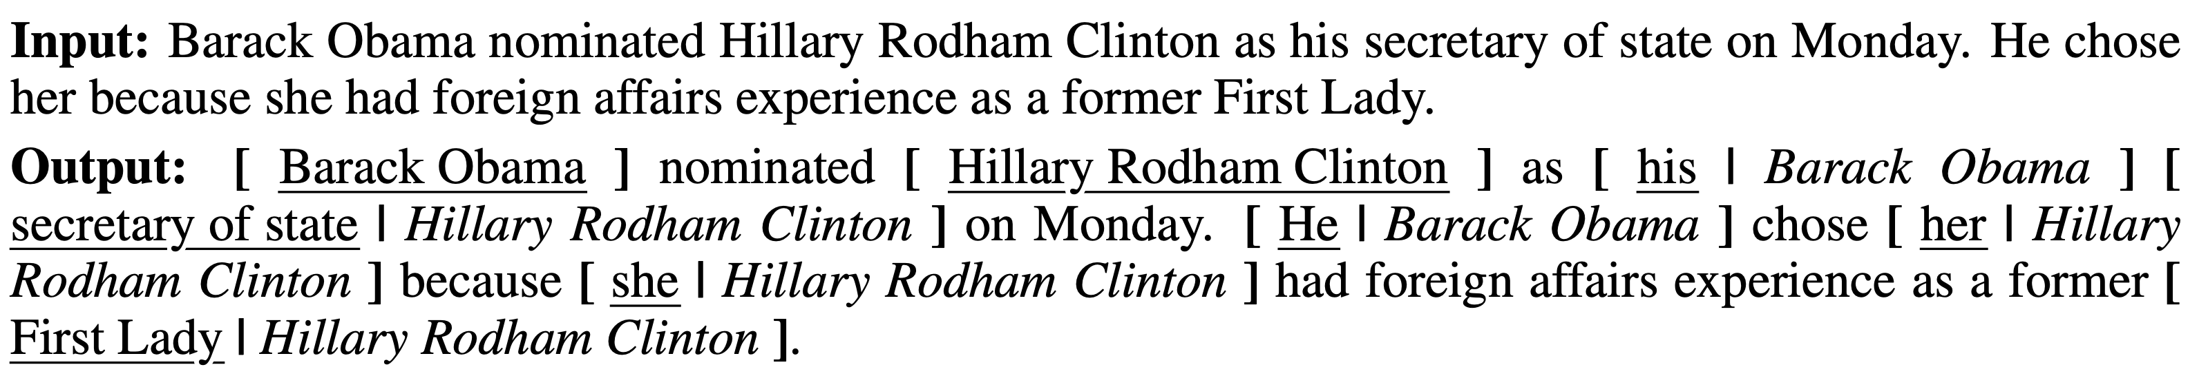
Proposed method: examples
Semantic role labeling:
Coreference resolution:

Slide 18
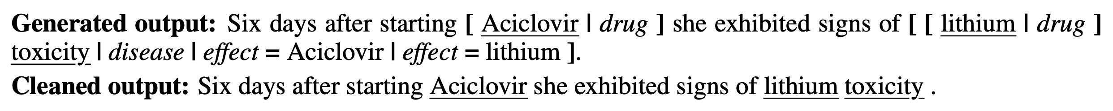
Proposed method
Decoding procedure:
Extract entity types and relations (without special tokens)
Align input and output sentence on the token level (improves robustness).
For each relation in the output find the closest entity which exactly matches the tail entity, discard otherwise.
Discard entity and relations which do not belong to the predefined types.

Slide 19
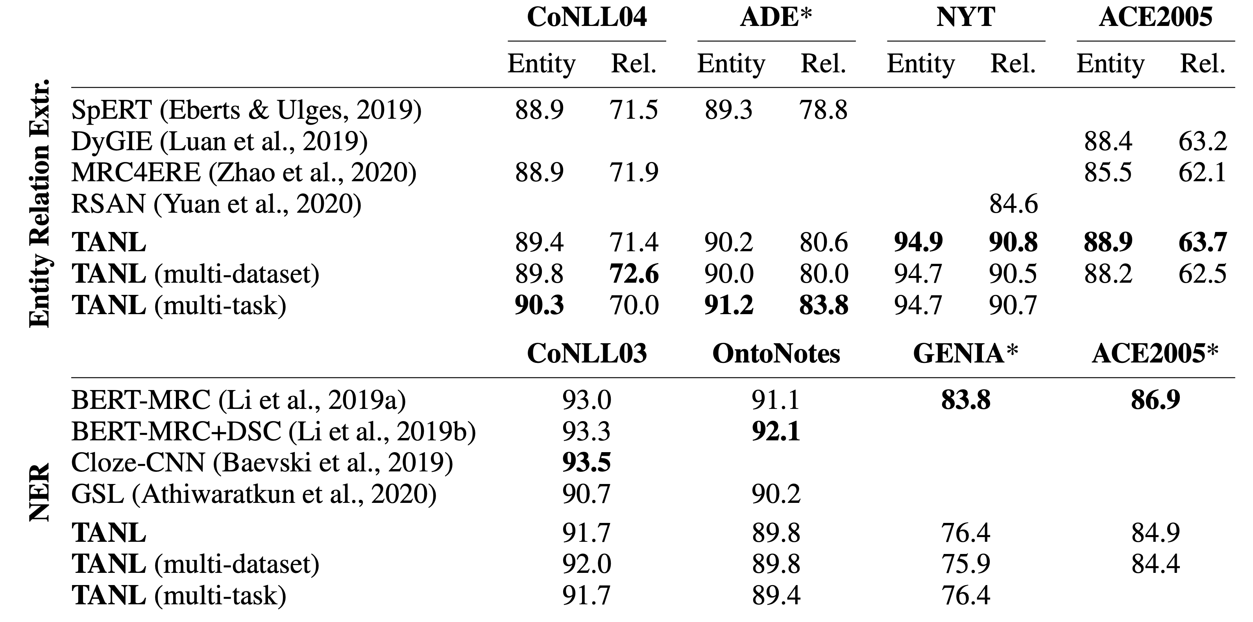

Experimental results

Slide 20
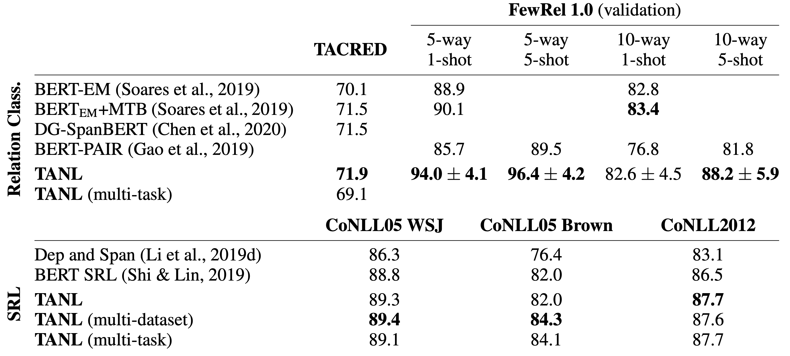

Experimental results

Slide 21
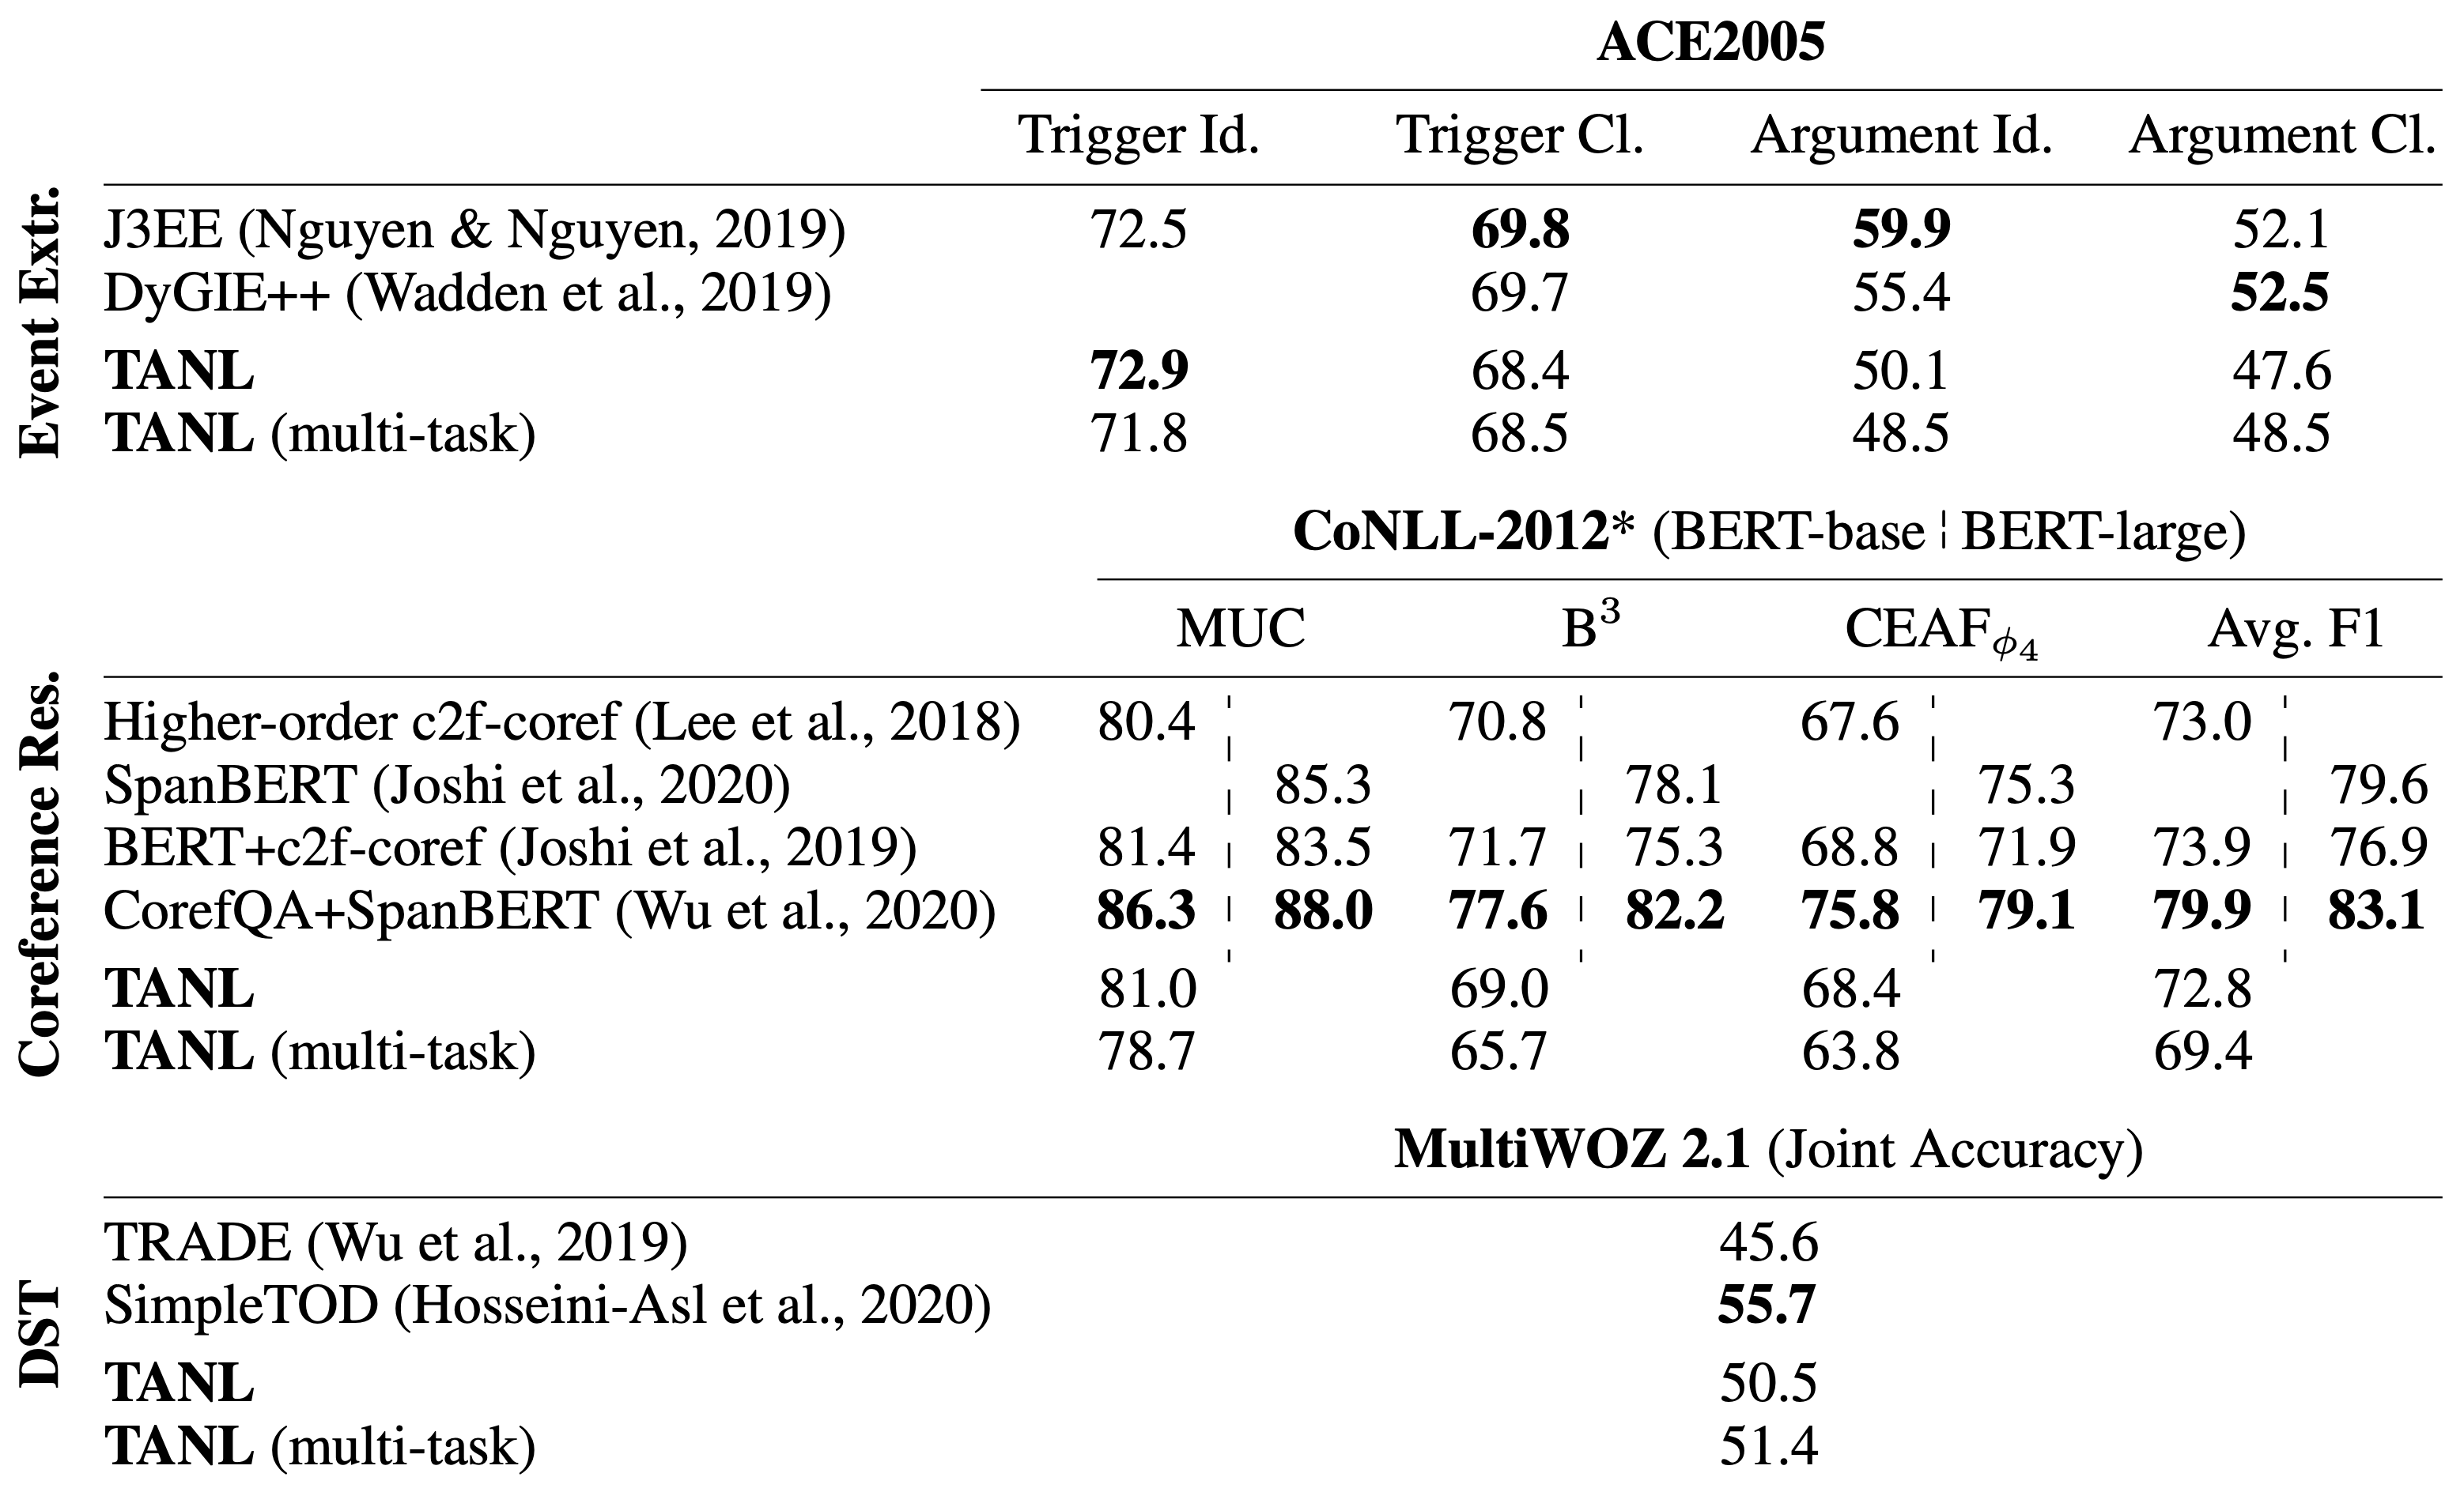


Experimental results

Slide 22
Experimental results
Observations:
Across the board: TANL state-of-the art or competitive
Multi-task model is competitive, significant improvements for low-resource datasets
Poorer performance of multi-task on coreference resolution might be due to much longer texts (compared to other tasks)
Good performance in few-shot classification

Slide 23
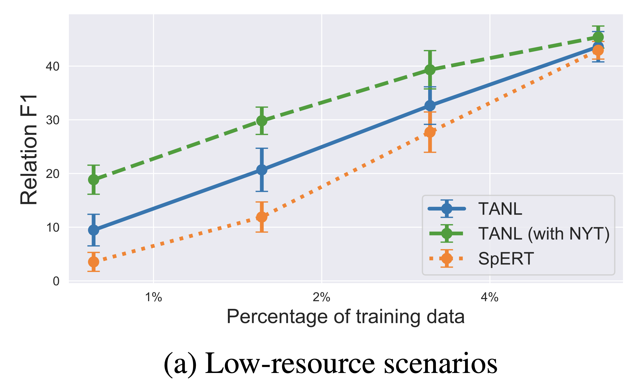
Experimental results

Slide 24
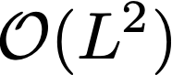

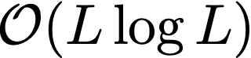
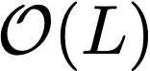
Discussion
Drawback of the generative approach as implemented here:
Time complexity of token generation is where is the sequence length.
However: Reformer (Kitaev et al., 2020) and Linformer (Wang et al. 2020) reduce this to and respectively.

Slide 25
Conclusion
To summarize:
Authors propose a text-to-text translation framework which unifies many structured prediction tasks.
New state-of-the-art for some tasks, competitive results on all tasks.
Train multi-task model which can perform reasonably well across all tasks
Especially low-resource datasets can benefit from multi-task model with significant performance gains.

Slide 26
Additional references (and figures)
Athiwaratkun, Ben, et al. "Augmented Natural Language for Generative Sequence Labeling." arXiv preprint arXiv:2009.13272 (2020).
Eberts, Markus, and Adrian Ulges. "Span-based joint entity and relation extraction with transformer pre-training." 24th European Conference on Artificial Intelligence (ECAI). 2020.
Kitaev, Nikita, Łukasz Kaiser, and Anselm Levskaya. "Reformer: The efficient transformer." arXiv preprint arXiv:2001.04451 (2020).
Lee, Joohong, Sangwoo Seo, and Yong Suk Choi. "Semantic relation classification via bidirectional LSTM networks with entity-aware attention using latent entity typing." Symmetry 11.6 (2019): 785.
Miwa, Makoto, and Yutaka Sasaki. "Modeling joint entity and relation extraction with table representation." Proceedings of the 2014 Conference on Empirical Methods in Natural Language Processing (EMNLP). 2014.
Wang, Sinong, et al. "Linformer: Self-attention with linear complexity." arXiv preprint arXiv:2006.04768 (2020).
Zhang, Haiyang, Guanqun Zhang, and Yue Ma. "Syntax-Informed Self-Attention Network for Span-Based Joint Entity and Relation Extraction." Applied Sciences 11.4 (2021): 1480.

